Slide 1


Slide 2

Abstract and Problem Statement
Abstract
Start from the reference LSTM portfolio model (Zhang, Zohren & Roberts, 2020) and test it against 7 benchmarks.
Compare LSTM, Attention, LSTM+EIIE and Attention+EIIE under one identical protocol; winner chosen on validation Sharpe only.
Plain LSTM wins: validation Sharpe 2.56 and highest test Sharpe in all 3 experiments.
Same 4 models retrained on Indian ETFs: Attention wins Exp 1–2, LSTM wins Exp 3.
Problem statement
Can a network read raw market history and output portfolio weights directly, trained to maximise the Sharpe ratio?
Classical (Markowitz) methods rely on unstable return and correlation estimates.
Diversification breaks down in crises; normal-return assumptions miss fat tails.
Predicting returns well ≠ building the best portfolio.
Old: predict prices → optimise
New: market data → weights
We test if attention and EIIE improve a Sharpe-trained LSTM, and if it works in India.
Notes:
TIME ~1:00. We start from the Zhang-Zohren-Roberts Sharpe-trained LSTM, then test whether attention and EIIE improve it, in a 2x2 design, and finally retrain all four models on Indian ETFs. The problem: classical portfolio theory needs unstable estimates; we instead map market history directly to weights, trained on Sharpe.

Slide 3
Aim and Objectives
Aim
To evaluate, under a single controlled protocol, whether attention and EIIE improve a Sharpe-trained LSTM portfolio model, and which of the four models works best on Indian ETFs.
1
2
3
4
Baseline LSTM
Comparison
India
Transparency
Re-implement the reference LSTM and test it against 7 independently computed benchmarks.
Compare LSTM, Attention, LSTM+EIIE and Attention+EIIE under identical conditions.
Retrain all four models on Indian ETFs; name the winner of each experiment.
Record every deviation and caveat; no number quoted without its limits.
Notes:
TIME ~0:45. Aim: evaluate, under one controlled protocol, whether attention and EIIE improve a Sharpe-trained LSTM, and which of the four models works best on Indian ETFs. Five objectives, all completed.

Slide 4
Dataset
Asset class | US ETFs (Part 1) | Indian ETFs (Part 2)
Stock | VTI | NIFTYBEES.NS
Bond | AGG | LTGILTBEES.NS
Commodity | DBC | GOLDBEES.NS
Volatility | ^VIX | ^INDIAVIX
US (Part 1)
7 Feb 2006 – 29 Apr 2020: 3,581 trading days.
Retrain 2011, 2013, 2015, 2017, 2019; test to Apr 2020.
India (Part 2)
21 Jun 2019 – 30 Oct 2026: 1,776 days.
Test: 3 Jan 2022 – 30 Oct 2026.
Annualised | VTI | AGG | DBC | ^VIX
Mean return | 0.101 | 0.045 | -0.030 | 0.825
Std deviation | 0.203 | 0.051 | 0.194 | 1.287
Source: Yahoo Finance (yfinance). Input = 50 days × 8 = 400 features; z-score fitted only on past data.
US daily returns: very different risk across the 4 asset classes
Notes:
TIME ~0:50. Four asset classes in each market: stock, bond, commodity and volatility. US data from Yahoo Finance, 2006 to April 2020, 3,581 days. Indian ETFs, June 2019 to October 2026, 1,776 days. Each input is 50 days times 8 features, 400 inputs.

Slide 5
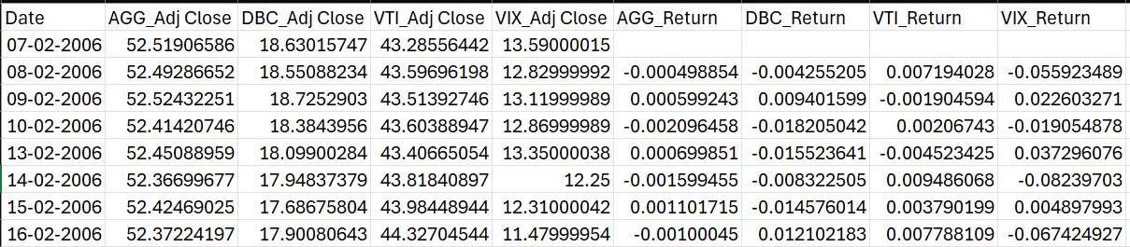
Dataset
Notes:
TIME ~0:50. Four asset classes in each market: stock, bond, commodity and volatility. US data from Yahoo Finance, 2006 to April 2020, 3,581 days. Indian ETFs, June 2019 to October 2026, 1,776 days. Each input is 50 days times 8 features, 400 inputs.

Slide 6
Methodology and Pipeline
1
2
3
4
5
Feature stacking
Neural encoding
Softmax
Return realisation
Sharpe optimisation
→
→
→
→
Stack 50 days × 4 assets (price + return) into one 50×8 input block.
Model (LSTM or Attention, ± EIIE) reads the window and outputs one raw score per asset.
Scores become long-only weights in [0,1] that sum to 1.
Portfolio return = weights × actual returns − transaction costs (optional volatility scaling).
Loss = −Sharpe; backpropagation updates the model to raise it.
Same data, loss and optimiser for all 4 models
Adam · batch 64 · 100 epochs
Validation: last 10% (chronological)
3 seeds (0, 1, 2); results = mean
Retrain every 2 years, expanding window
Winner picked on validation; test used once
Fair comparison: only the model architecture changes; everything else is held fixed.
Notes:
TIME ~1:00. Five steps: stack 50 days of four assets, encode with the model, softmax to long-only weights, compute net portfolio return, and optimise negative Sharpe by gradient ascent. Every model gets the identical protocol: Adam, 100 epochs, last 10 percent validation, seeds 0 to 2, retrain every two years.

Slide 7
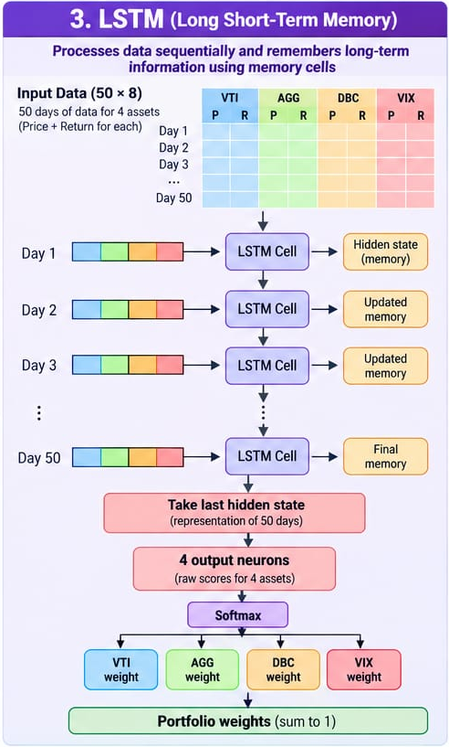
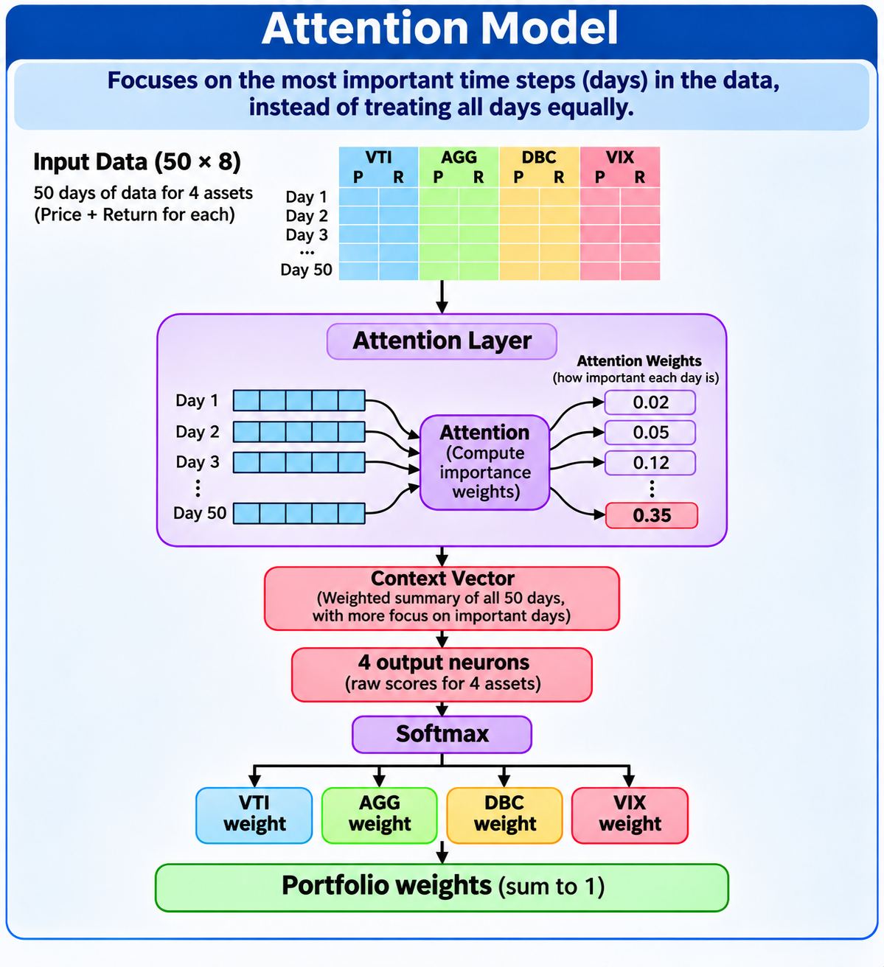
Models Overview: LSTM and Attention
A · LSTM
B · Attention
C · LSTM + EIIE
D · Attention + EIIE
A · LSTM: reads day by day
Processes the 50 days one at a time, updating a memory (hidden state).
Gates decide what to keep or forget, so long-term patterns survive.
Last hidden state summarises 50 days → 4 scores → softmax weights.
B · Attention: looks at all days at once
Every day attends to every other day and learns which past days matter most.
Query, Key, Value
Pool compresses everything into one summary, then softmax turns it into portfolio weights .
Positional Encoding
LSTM = sequential memory (compact). Attention = global comparison (heavy).
Notes:
TIME ~1:10. Four models: A LSTM, B Attention, C LSTM+EIIE, D Attention+EIIE. The LSTM reads the 50 days one day at a time and keeps a memory; its last memory becomes four scores and then softmax weights. Attention instead looks at all 50 days at once and learns which days matter, but it has about 21 times more parameters.

Slide 8
Why EIIE helps :
Joint input (A, B)
EIIE (C, D): one shared evaluator per asset
VTI (50×2)
→
shared encoder
→
1 score
50×8 window
(all 4 assets)
one encoder
4 raw scores
soft-
max
softmax
→ weights
AGG (50×2)
→
shared encoder
→
1 score
→
→
→
DBC (50×2)
→
shared encoder
→
1 score
VIX (50×2)
→
shared encoder
→
1 score
Shared weights
Same mini-network for every asset
Consistent scoring
Every asset is evaluated by the same rule, so scores are directly comparable.
Scalable
Assets can be added or removed without changing the architecture.
Independent streams
Each stream sees only its own asset; streams interact only at the softmax.
EIIE: Ensemble of Identical Independent Evaluators
Notes:
TIME ~0:55. EIIE, Ensemble of Identical Independent Evaluators from Jiang et al. 2017: instead of one network seeing all assets, the same small network scores each asset on its own and the scores meet only at the softmax. In theory this shares parameters, scales to any number of assets, and scores every asset consistently. In our tests, as designed, it did not help.

Slide 9
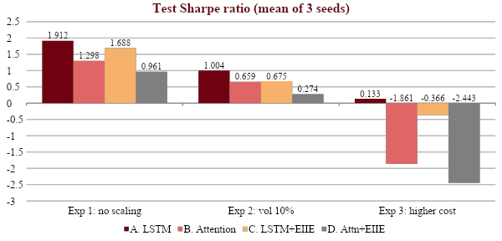
Results: Four Models (US Data)
Validation | A. LSTM | B. Attn | C. LSTM+E | D. Attn+E
Val. Sharpe | 2.562 | 1.775 | 2.051 | 0.913
Winner: A · LSTM
Highest validation Sharpe (2.562): chosen before any test number.
Highest test Sharpe in all 3 experiments.
Smallest model (19,204 parameters) yet best.
Experiments
Exp 1: no vol scaling, C = 0.01%
Exp 2: vol target 10%, C = 0.01%
Exp 3: vol target 10%, C = 0.1%
Takeaway: Plain LSTM wins on validation (2.562) and on test Sharpe in 3 of 3 experiments.
Notes:
TIME ~1:00. Test Sharpe for the four models in the three experiments. The LSTM, model A, is highest in all three: 1.912, 1.004 and 0.133. It was also selected on validation Sharpe, 2.562, before any test number was seen. Attention models collapse when costs are raised in Experiment 3.

Slide 10
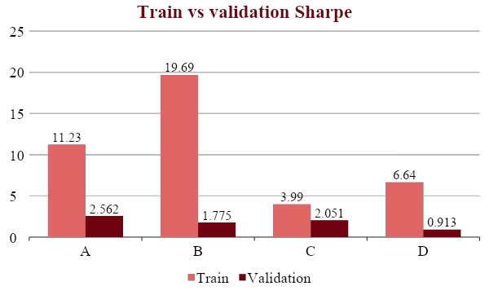
Why the LSTM Won
1 · Attention overfits
≈ 21× the parameters: it memorises the training period.
Train Sharpe 19.7 vs validation 1.8 (B).
2 · Attention over-trades
Increased Transactions Cost
Costs *10 - (Exp 3): B −1.86, D −2.44, A +0.13.
Daily turnover: A 0.19 vs B 0.58, D 0.97.
3 · EIIE takes too much risk
Greater Risk without generating proportionately higher returns
Std 0.55 (C) vs 0.125 (A); MDD 0.35 vs 0.17.
C holds only 4% stock and 4% bonds.
4 · LSTM is balanced
Holds 51% stock, 22% bonds, 18% commodity, 9% volatility.
Matches the paper: Sharpe 1.912 vs 1.858.
Helps maintain balance between Returns, Risk and trading cost.
Takeaway: The LSTM generalises better, trades less and maintained better risk control than the alternative model we tested.
Notes:
TIME ~1:15. Four reasons. One, attention memorises: train Sharpe 19.7 against validation 1.8. Two, attention trades too much: turnover 0.58 and 0.97 against 0.19, so when costs rise tenfold they collapse. Three, EIIE takes about four times the risk. Four, the LSTM keeps a balanced portfolio, 51 percent stock, and matches the paper. Caveat: attention has 21 times the parameters, so this applies to the designs tested.

Slide 11
Indian Dataset: Training the 4 Models on Indian ETFs
Model | Params | Val. Sharpe | Seed sd
A. LSTM | 19,204 | 1.564 | 1.854
B. Attention | 14,788 | -0.049 | 0.141
C. LSTM + EIIE | 17,473 | 0.307 | 1.273
D. Attn + EIIE | 14,497 | 0.498 | 1.409
Setup (same protocol as the US)
4 models × 3 seeds × 3 windows (2022, 2024, 2026) = 36 fits.
Test: 3 Jan 2022 – 30 Oct 2026 (1,164 days).
Validation-selected winner: A · LSTM
Highest validation Sharpe (1.56) on the first window.
Core mix: 71% Nifty ETF + 22% gilts(government securities); lowest turnover (0.13).
Avg weights | Nifty | Gilt | Gold | VIX | Turn- over
A. LSTM | 0.71 | 0.22 | 0.03 | 0.04 | 0.13
B. Attn | 0.68 | 0.29 | 0.02 | 0.02 | 0.30
C. LSTM+E | 0.23 | 0.09 | 0.09 | 0.58 | 0.24
D. Attn+E | 0.13 | 0.21 | 0.08 | 0.58 | 0.53
Takeaway: EIIE models put ~58% in India VIX
Sharpe = return per unit of risk; seed = a repeat of training with a different random start; turnover = how much the weights change daily.
Notes:
TIME ~1:00. We retrained all four models on Indian ETFs with the same protocol: three seeds times three retraining windows, 2022, 2024, 2026, 36 fits. We use a compact attention encoder of about 14,800 parameters so capacity is closer to the LSTM. On validation data the LSTM is highest, 1.56, so it is the validation-selected winner. It holds mostly Nifty and gilts and has the lowest turnover. Caveat: the first validation set has only 56 samples.

Slide 12
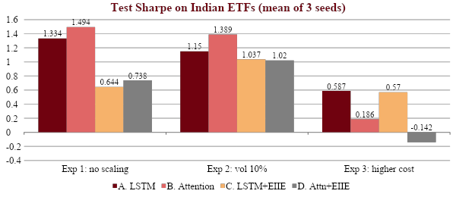
Results: Four Models on Indian ETFs
Reading the results
Low cost (Exp 1–2): Attention does best (1.49, 1.39).
High cost (Exp 3): LSTM does best (0.59).
Why: Attention trades a lot, so higher costs hurt it more (1.39 → 0.19)
EIIE: It wins nothing. It puts most of its money in India VIX, which you can’t actually trade.
Model A Sharpe | Exp 1 | Exp 2 | Exp 3
US (2011–Apr 2020) | 1.912 | 1.004 | 0.133
India (2022–Oct 2026) | 1.334 | 1.150 | 0.587
India experiment winner | B 1.494 | B 1.389 | A 0.587
Takeaway: India: Attention leads at low cost, LSTM at high cost; validation-selected LSTM.
Notes:
TIME ~1:10. Indian test Sharpe. Attention, B, wins Experiment 1, 1.49 against 1.33 for the LSTM, and Experiment 2, 1.39 against 1.15. The LSTM wins Experiment 3, 0.59, where costs are ten times higher: attention trades more, turnover 0.30 versus 0.13, and falls to 0.19. EIIE wins nothing. The margins for Exp 1 and 2 are within seed spread, so this is not a firm ranking; the LSTM remains the validation-selected winner. Fixed allocations beat every model under volatility scaling.

Slide 13
Conclusion
1
Baseline LSTM
2
Model comparison (US)
LSTM without volatility scaling has highest (Sharpe 1.912 ); but does not give highest Sharpe when volatility scaling is done.
Plain LSTM is best in all 3 experiments and on validation (2.56).
Attention and EIIE both did perform well. Attention was 21× bigger and memorised the training data.
3
India
4
Limits and next steps
LSTM is validation-selected. Attention wins Exp 1–2 (Sharpe: 1.49, 1.39), LSTM wins Exp 3 (Sharpe: 0.59).
The Indian dataset was much smaller than the US one: 1,777 days versus 3,581. This is because Indian ETFs are newer and the early data for gilt ETFs is sparse. As a result, we had only 56 validation samples and 3 seeds.
LSTM best in 3 of 3 US experiments | India: Attention 2, LSTM 1
Notes:
TIME ~0:45. To conclude: we matched the paper without volatility scaling, the plain LSTM beat attention and EIIE as designed here in all three US experiments, and on Indian ETFs results are close and promising but rest on short data and three seeds. Thank you.

Slide 14
THANK YOU!
Questions?
Notes:
Thank you. We are happy to take questions.

